Slide 1
Finding CAR # 173917391

Slide 2
CAR Review - 173917391
Is the nonconformity is fully addressed in the analysis? No. The analysis does not address the lack of calibration at the needed range. It only presents excuses.
Does the analysis supports the root cause statement? Not completely. The analysis does not explain why they felt a ‘pre-check’ could be used in place of calibration.
Does the analysis support the Scope of Nonconformance statement? Yes, based on Analysis stating test conducted at Kashima lab.
Will the Corrective Action Plan will prevent the recurrence of the nonconformity? Yes, the equipment is now calibrated up to 6kV.

Slide 3
CAR Review - 173917391
Did the containment milestone “stopped the bleeding”?
The containment milestone attachment is in another language however the second milestone shows that the equipment was re-calibrated and found to be within acceptable limits.
Did all corrective action milestones are aligned to each item of the corrective action plan?
Yes.
Did the verification milestone confirm the effective implementation of the corrective action plan?
Yes, based on the acceptable calibration results and the label being put on the equipment.

Slide 4
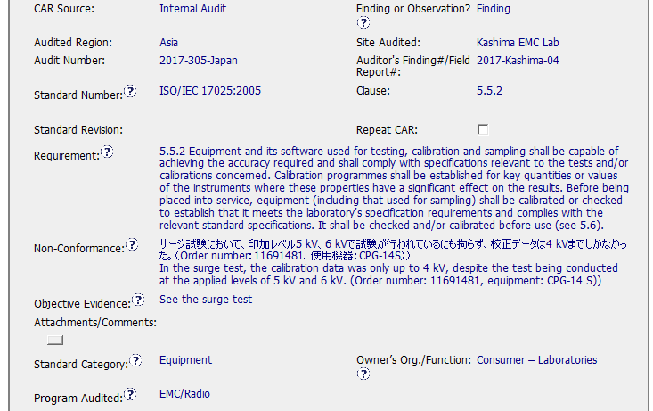
CAR Review - 173917391

Slide 5
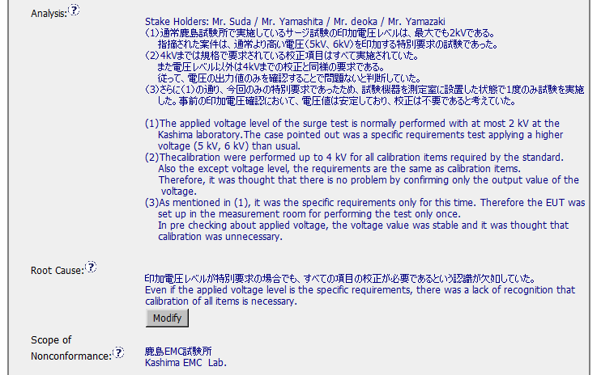
CAR Review - 173917391

Slide 6
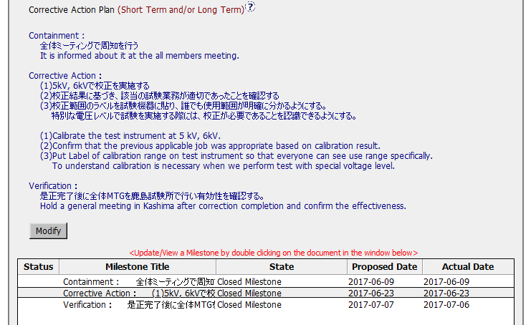
CAR Review - 173917391

Slide 7
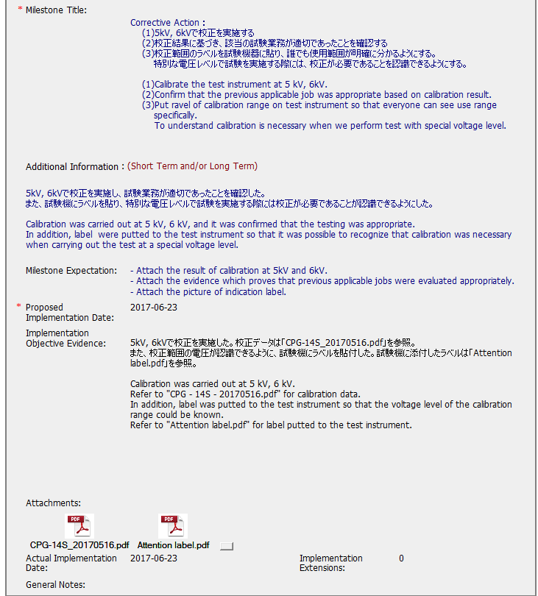
CAR Review - 173917391

Slide 8
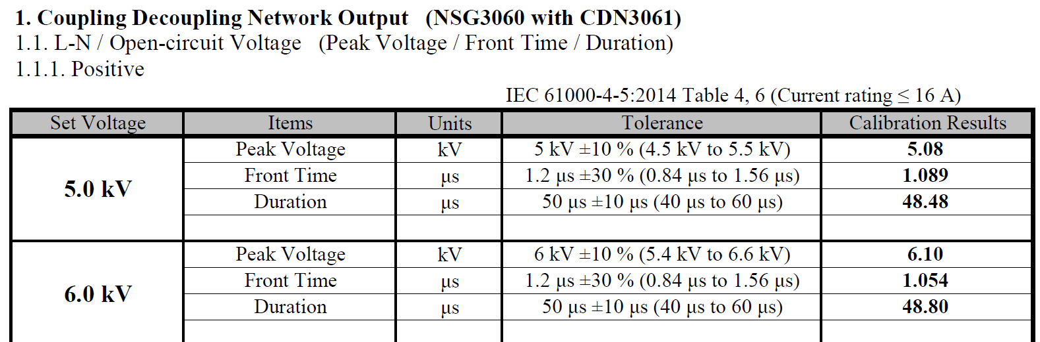
CAR Review – 173917391 Portion of calibration record

Slide 9
CAR Review – NA West Team Q4 2017
Ken Berger
Nancy Gruspe
Paul Mouawad​
Curtis L Robinson​

Slide 10
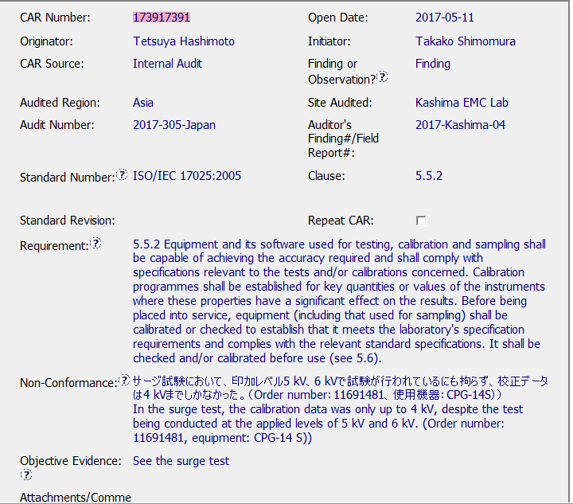
Finding CAR # 173917391

Slide 11
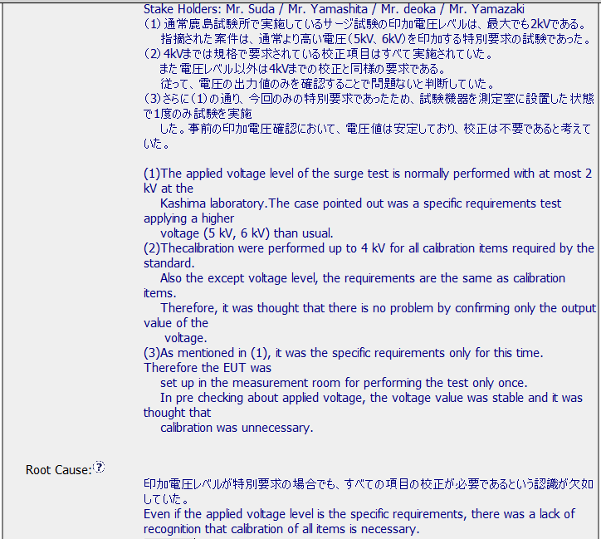
Finding CAR # 173917391 – Analysis and Root Cause

Slide 12
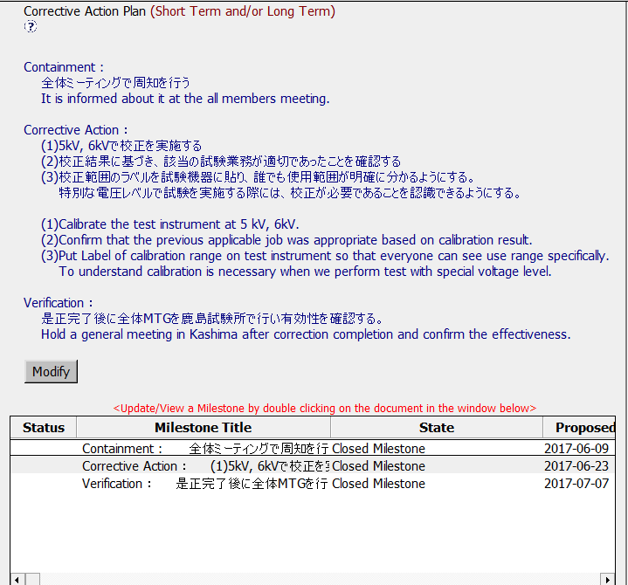
Finding CAR # 173917391

Slide 13
Finding CAR # 173917391
Explain how/If the nonconformity is fully addressed in the analysis
(PM) The analysis identified several stakeholders who participated in the analysis to ensure that all aspects are considered. The owner/team seems to have used the Brainstorming method to analyze the problem and determine the cause. However, it's not clear if the analysis covered other similar instruments usage above 4kV and possible data that may be impacted – scope? Also, the analysis did not show or discuss whether it's required to perform calibration at the higher voltage (it may or may not be necessary). Is it a requirement based on Mfg. Spec? We can only 'assume' that it's required as stated in the CAR's non-conformance statement.

Slide 14
Finding CAR # 173917391 cont.
Explain how/If the analysis supports the root cause statement
(PM) The root cause statement was able to draw from the analysis and provide the specific reasoning that led to the decision not to calibrate at the higher voltage.
Explain how/If the analysis supports the Scope of Nonconformance statement
(KB) It doesn’t; there is no statement about whether or not other equipment was considered.

Slide 15
Finding CAR # 173917391 cont.
Explain why/If the Corrective Action Plan will prevent the recurrence of the nonconformity
(KB) Only if this was an isolated piece of equipment, there is no statement that additional equipment was to be checked or considered.
Explain how/If the containment milestone “stopped the bleeding”
(NTG) The proper calibration method was announced in a meeting. This stops the spread of the incorrect method by notifying staff of the correct method.

Slide 16
Finding CAR # 173917391 cont.
Confirm that/If all corrective action milestones are aligned to each item of the corrective action plan
(NTG) The milestones directly correlated with the corrective action items. The item titled “Corrective Action” covered 3 tasks that were listed in both the corrective action plan and within the milestone.
Explain how/If the verification milestone confirmed the effective implementation of the corrective action plan
(CR) The verification milestone did not confirm the effective implementation of the corrective action plan
Although the CAR Owner provided evidence that a meeting occurred to discuss the actions taken including the implementation of Corrective Action #3 (Label of calibration range on test instrument) additional verification evidence could have been provided with evidence that a sample of new applicable projects being currently tested are appropriate, based on the updated calibration of the equipment

